Slide 1
WTW Jan Lagrand Top of the bill !

Slide 2
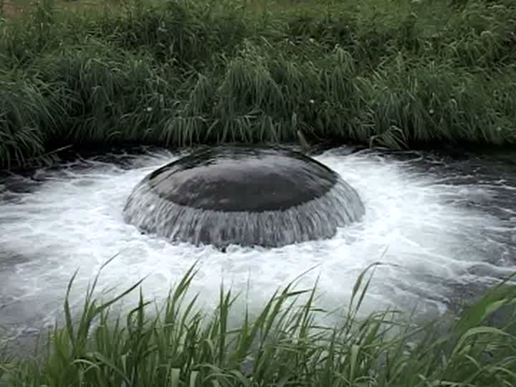
PWN at a glance
WTW Jan Lagrand

Slide 3
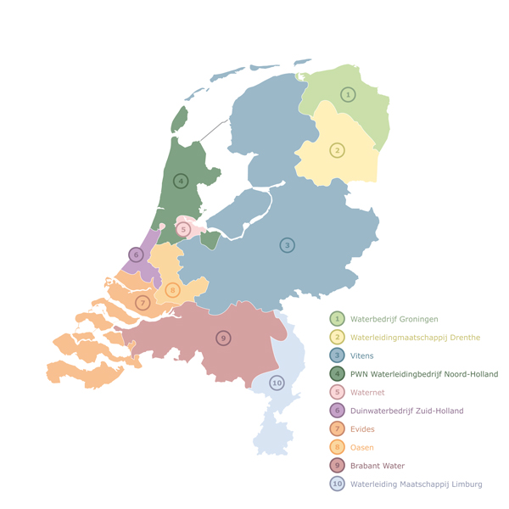
Position PWN in Dutch water community
10 Dutch water supply compagnies
Since 1950 many mergers
PWN fourth in size

Slide 4
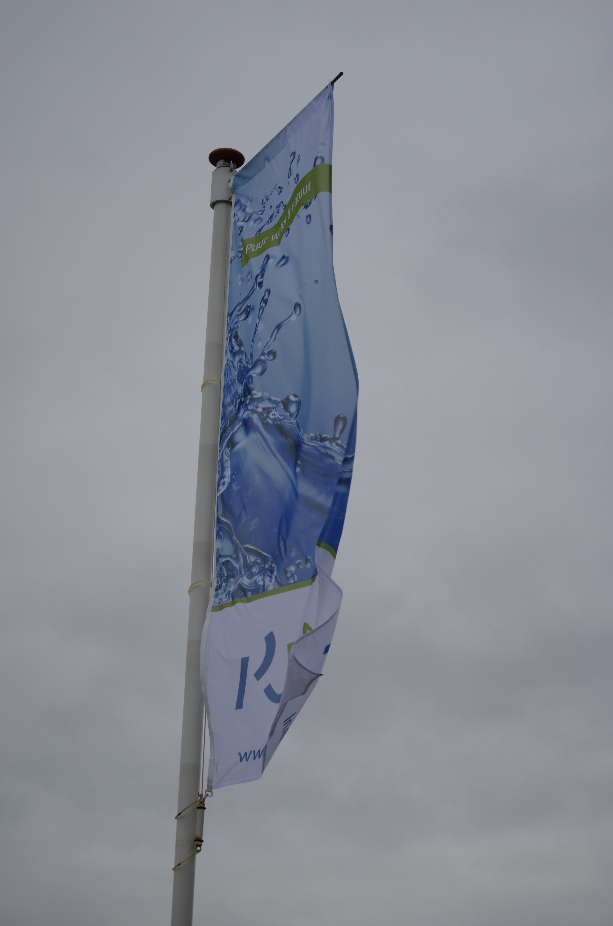
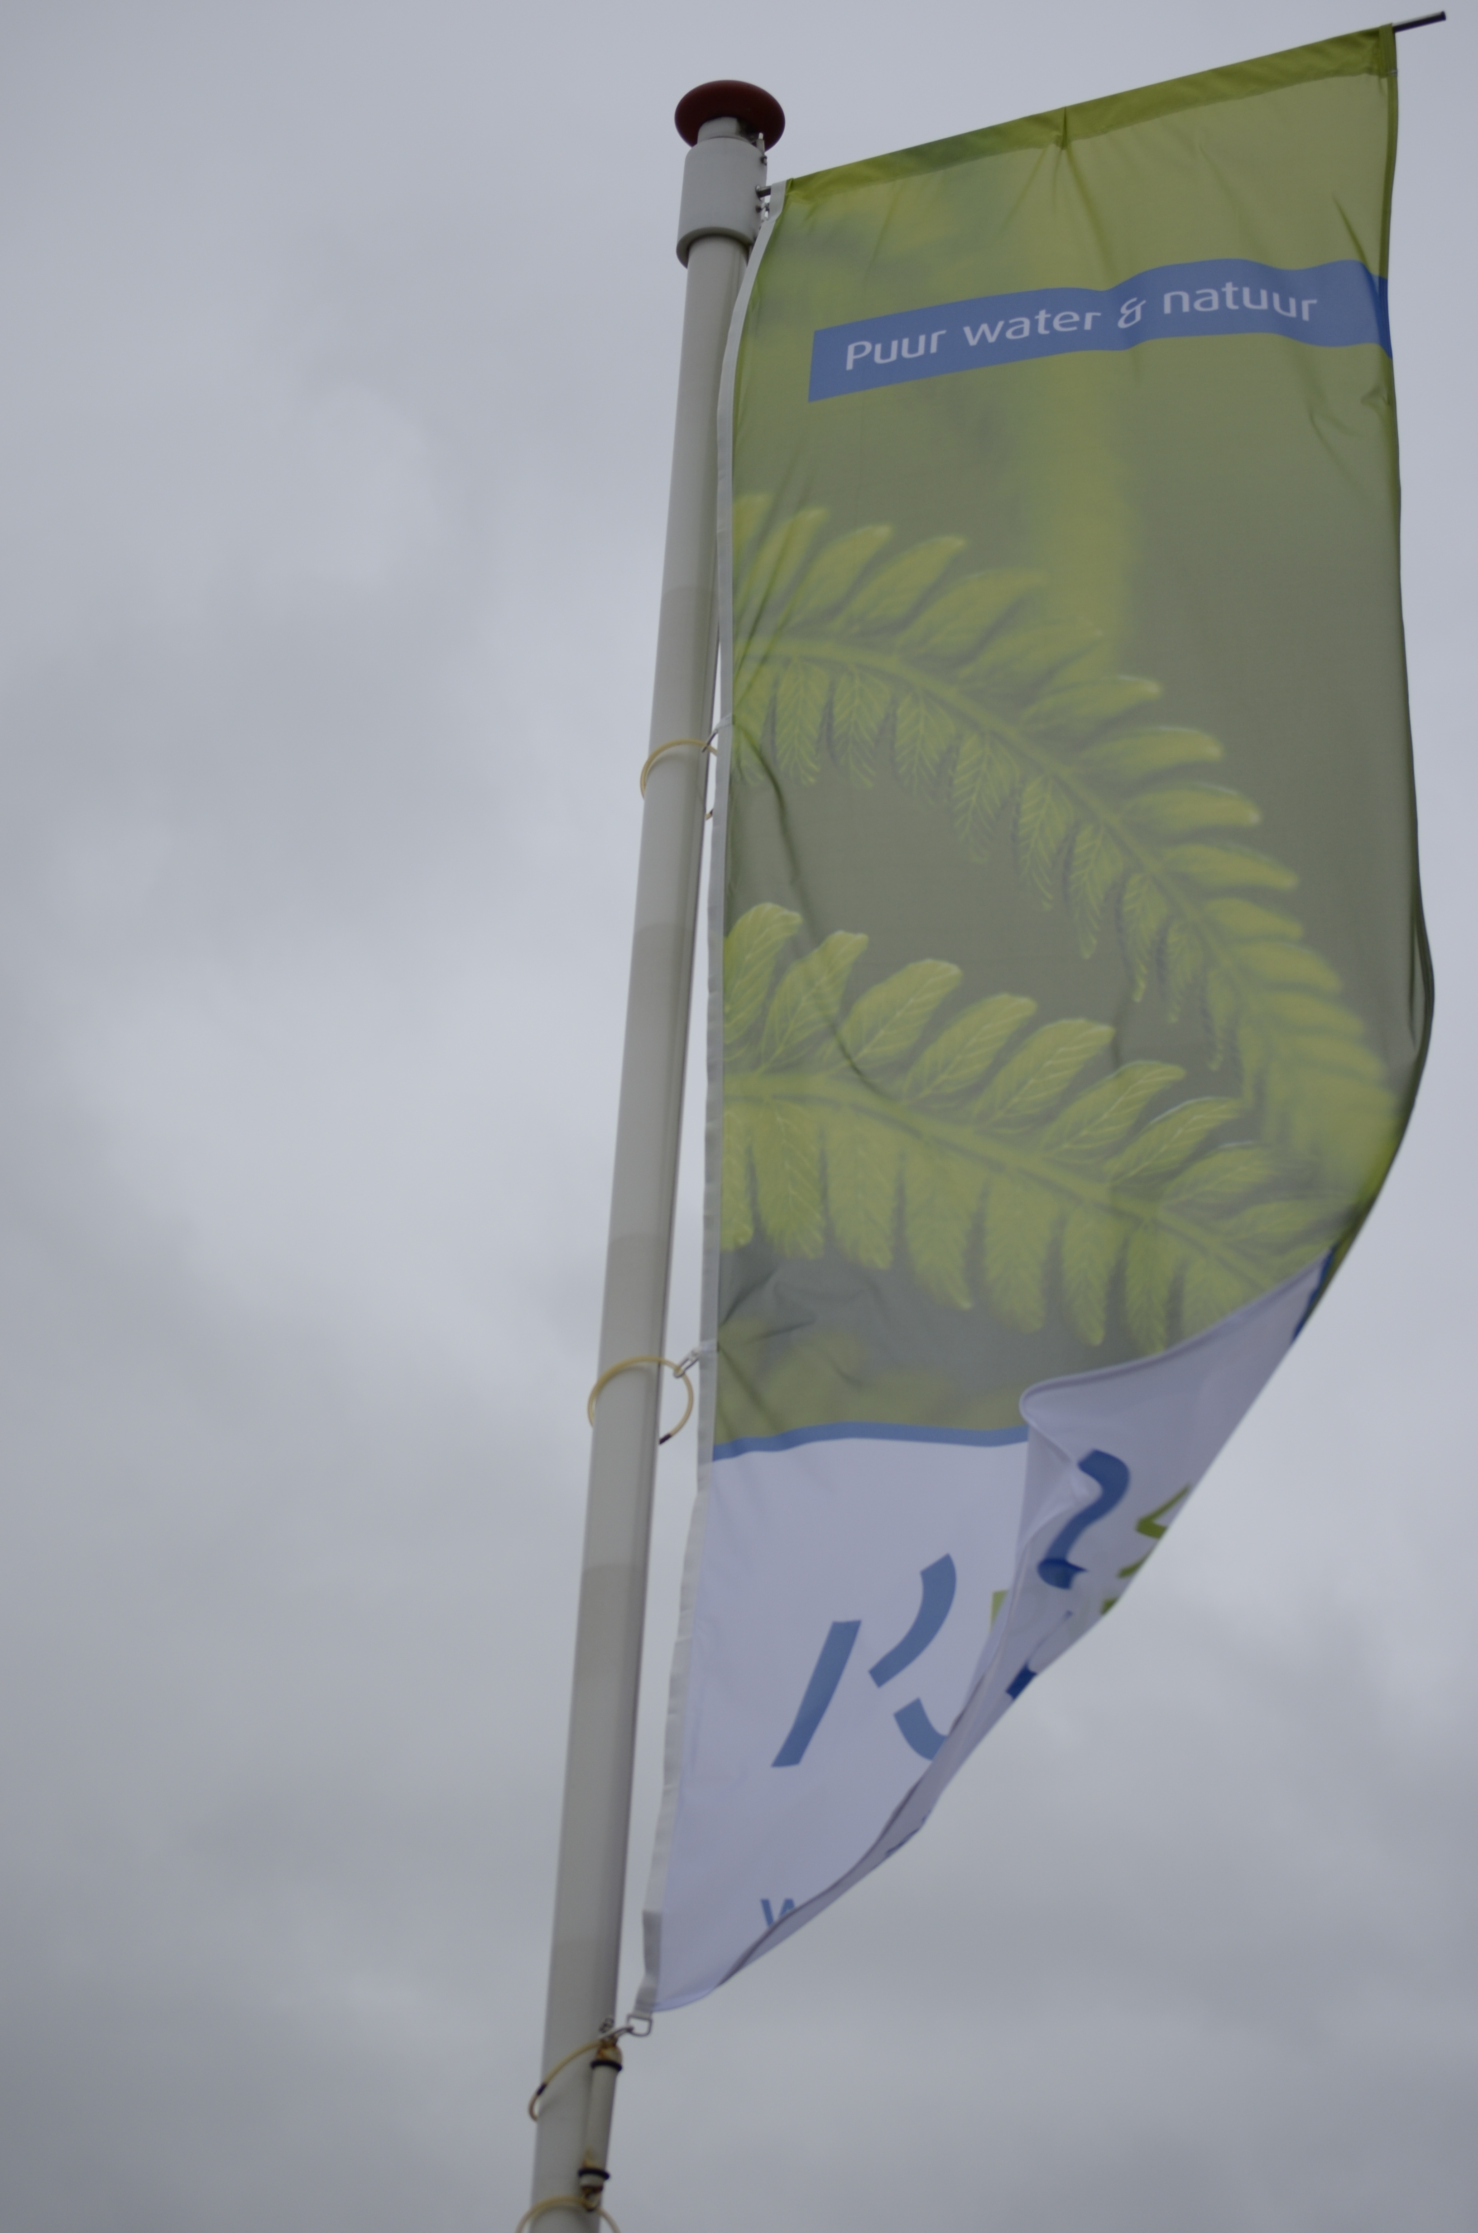
The organisation
PWN consists of three primary sectors
Drinking water
Nature & Recreation: management of dunes and recreation
facilities
Customer & Market: all customer
contacts
Three supporting departments:
Finance and Planning & Control dept.
Human Resources
Development & Innovation

Slide 5
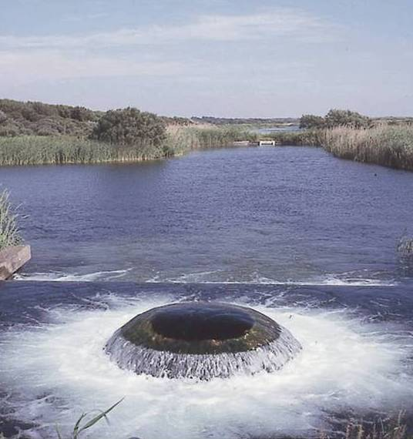
Core activities
Drinking water
775.000 connections to our network
105 billion litres of drinkingwater a year
About 130 litres per capita a day
Nature & Recreation
7.400 hectares dune area under management
7 million visitors a year
2 visitors centres: De Hoep and De Zandwaaier
3 independent campsites: The Kennemer Dune Campsites

Slide 6
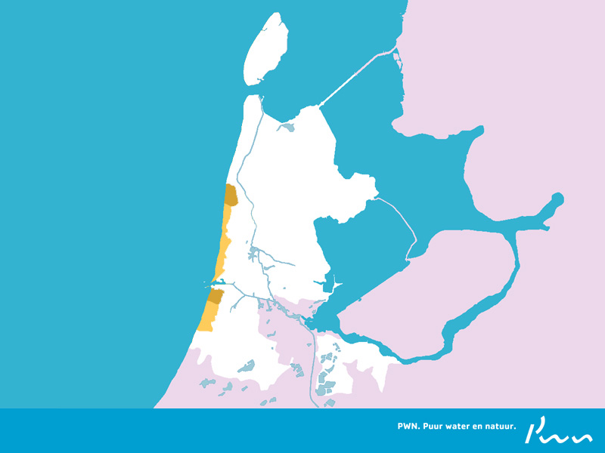
Service area PWN
Drinking water supply
Nature and Recreation

Slide 7
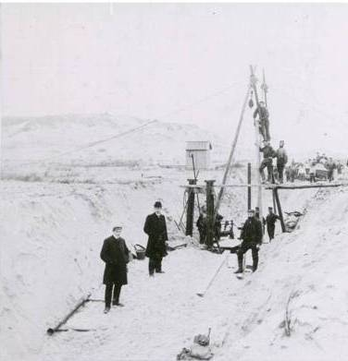
History PWN
1919 Province of North Holland decides to found PWN
1934 Province charges PWN
with the management of
Provincial natural areas
1956 Start infiltration of surface water into the dunes
1990 Privatization → N.V. PWN Waterleidingbedrijf Noord-Holland
1997 Merger between WLZK and PWN
2002 Reorganisation PWN
2009 Foundation PWN Technologies
2011 PWN starts to build AndijkIII

Slide 8
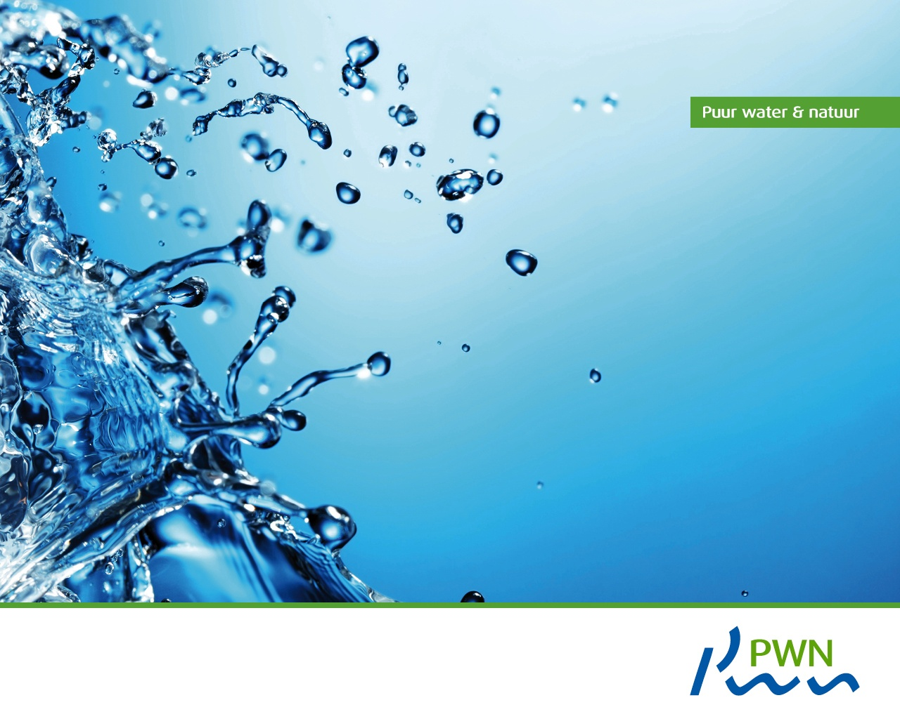
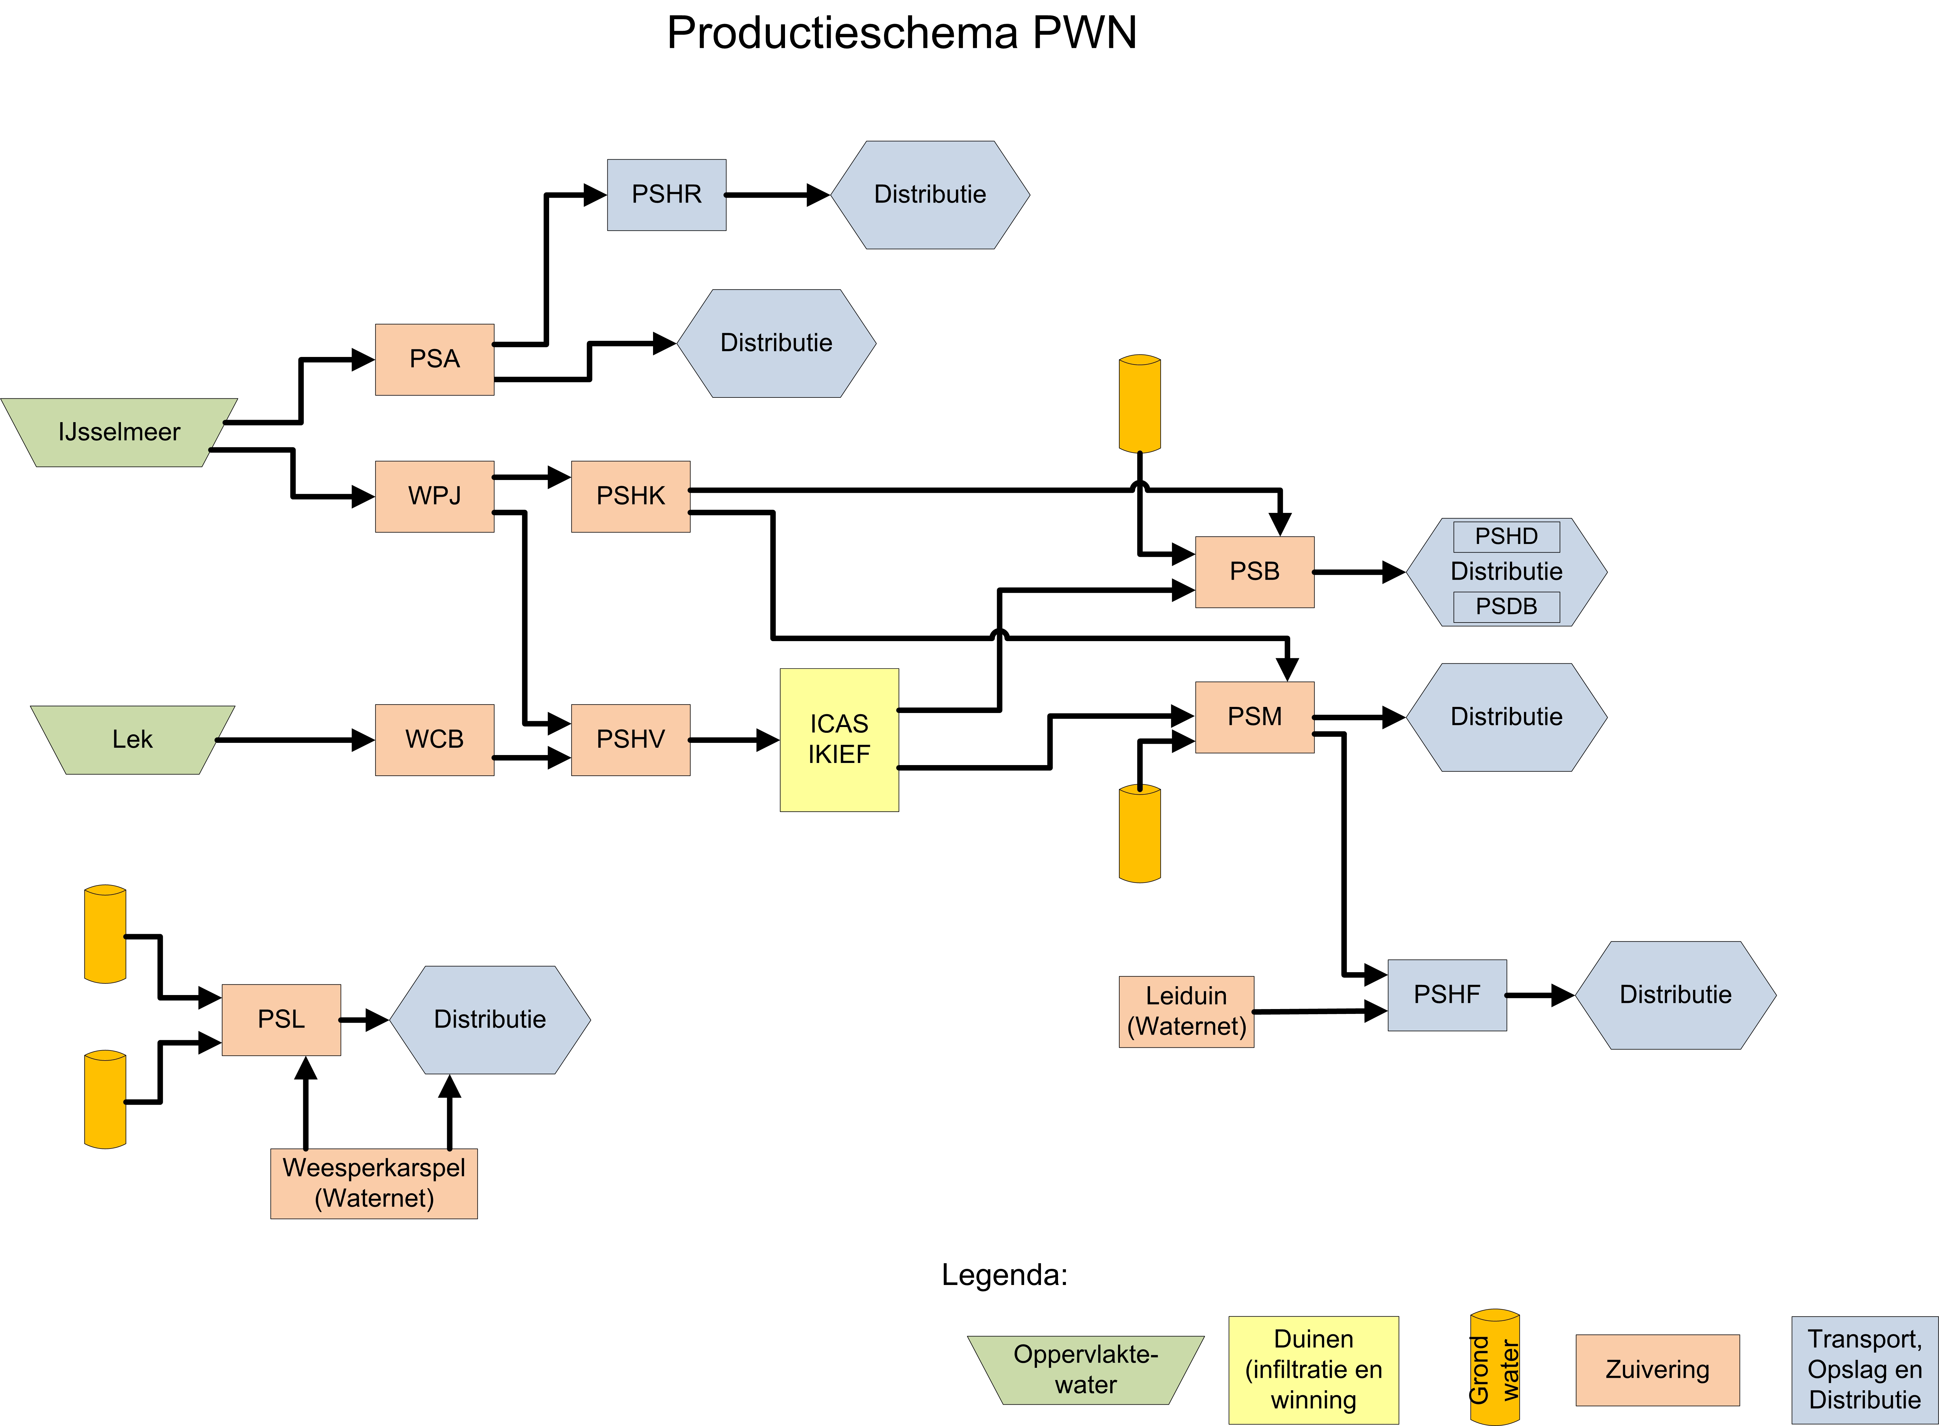
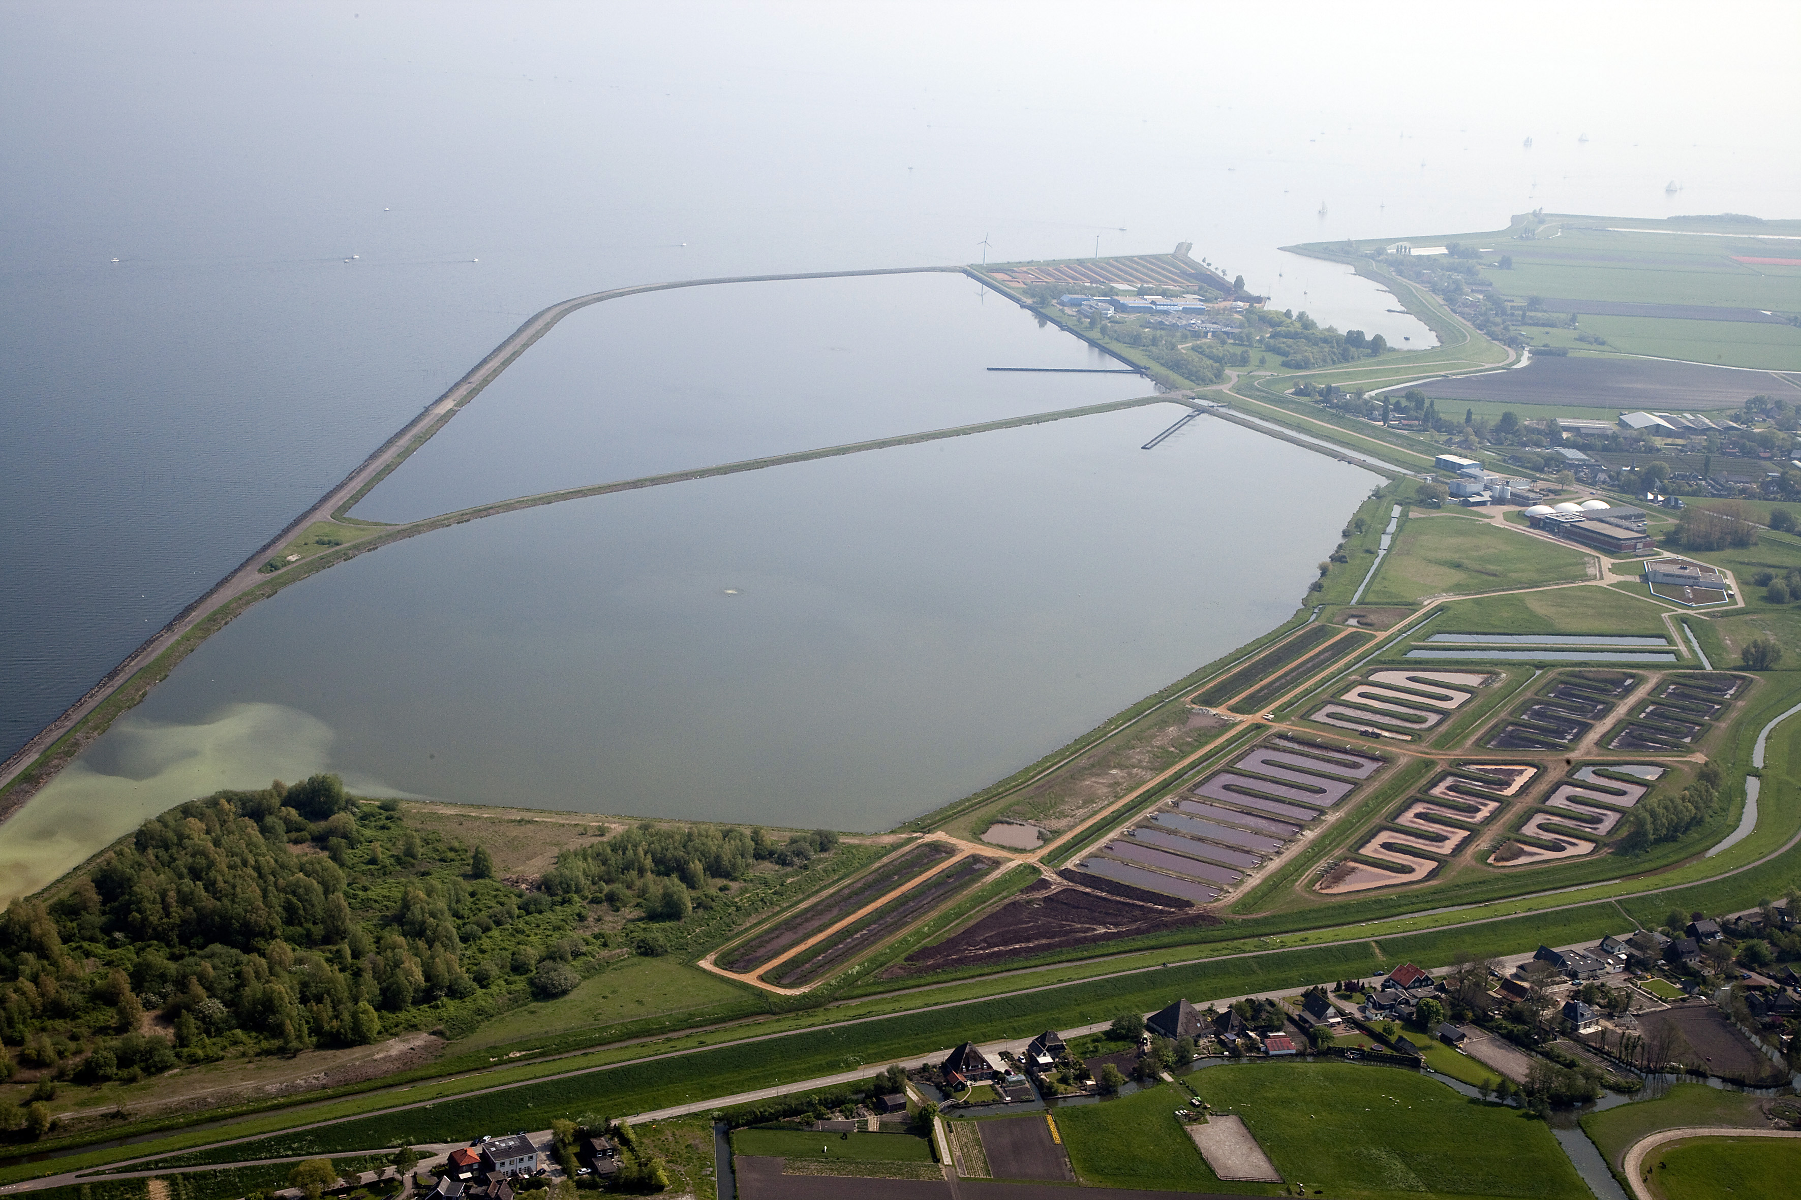
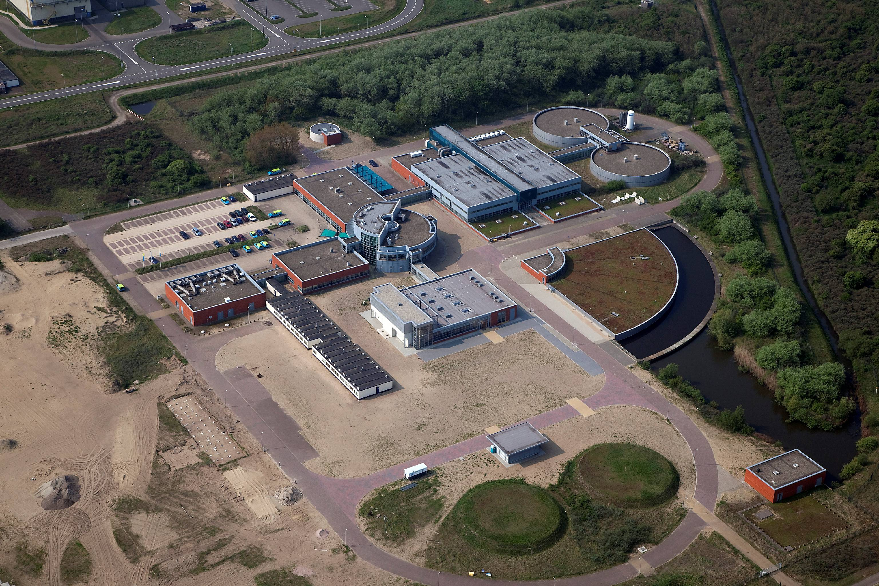
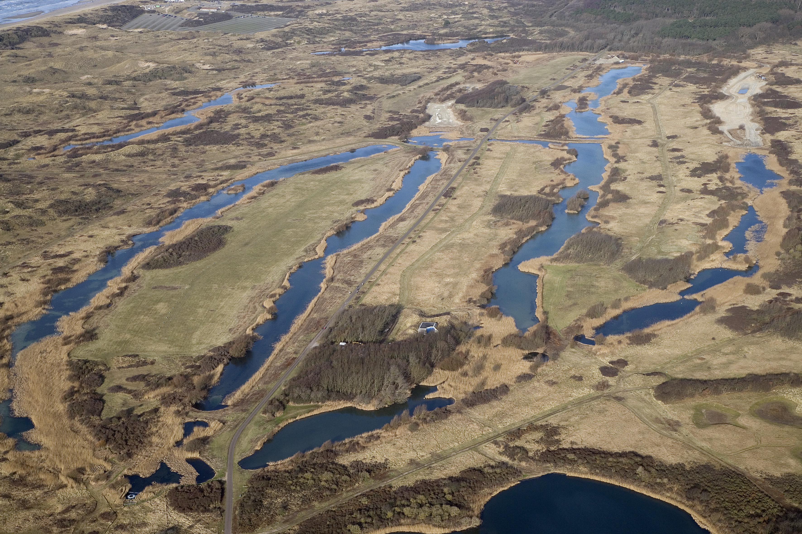
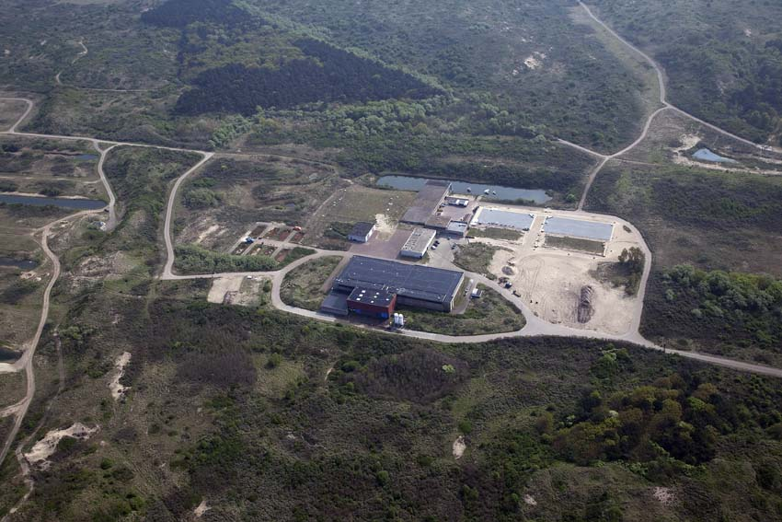
PWN Water Treatment Schemes
Notes:
8

Slide 9
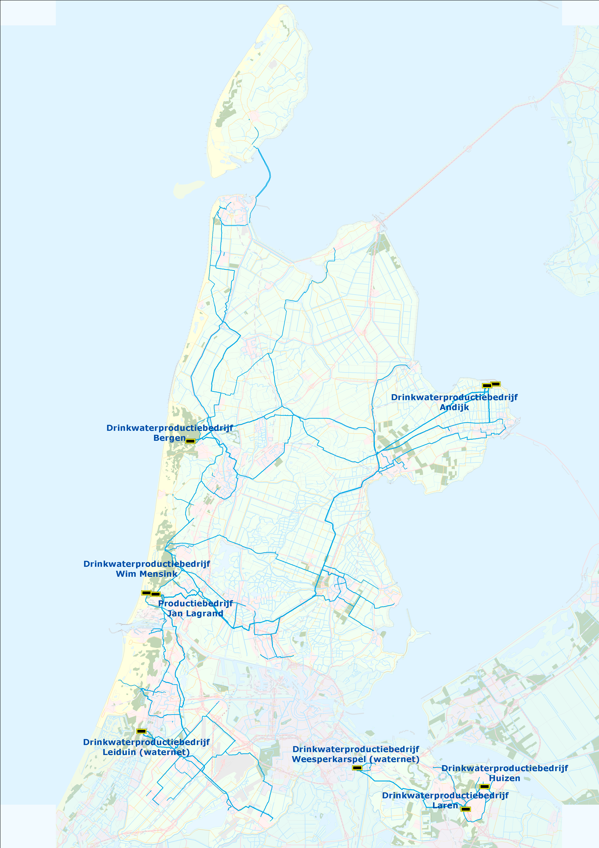
Production and transport
Direct purification at Andijk and Heemskerk
Production locations and storage reservoirs are coupled through a ring pipeline

Slide 10
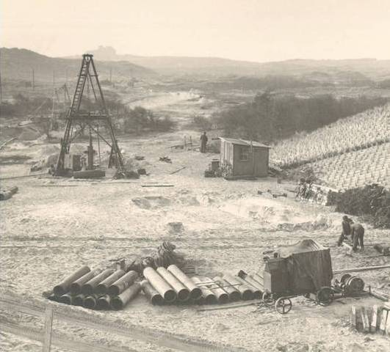
History PWN: link between water and nature

Slide 11
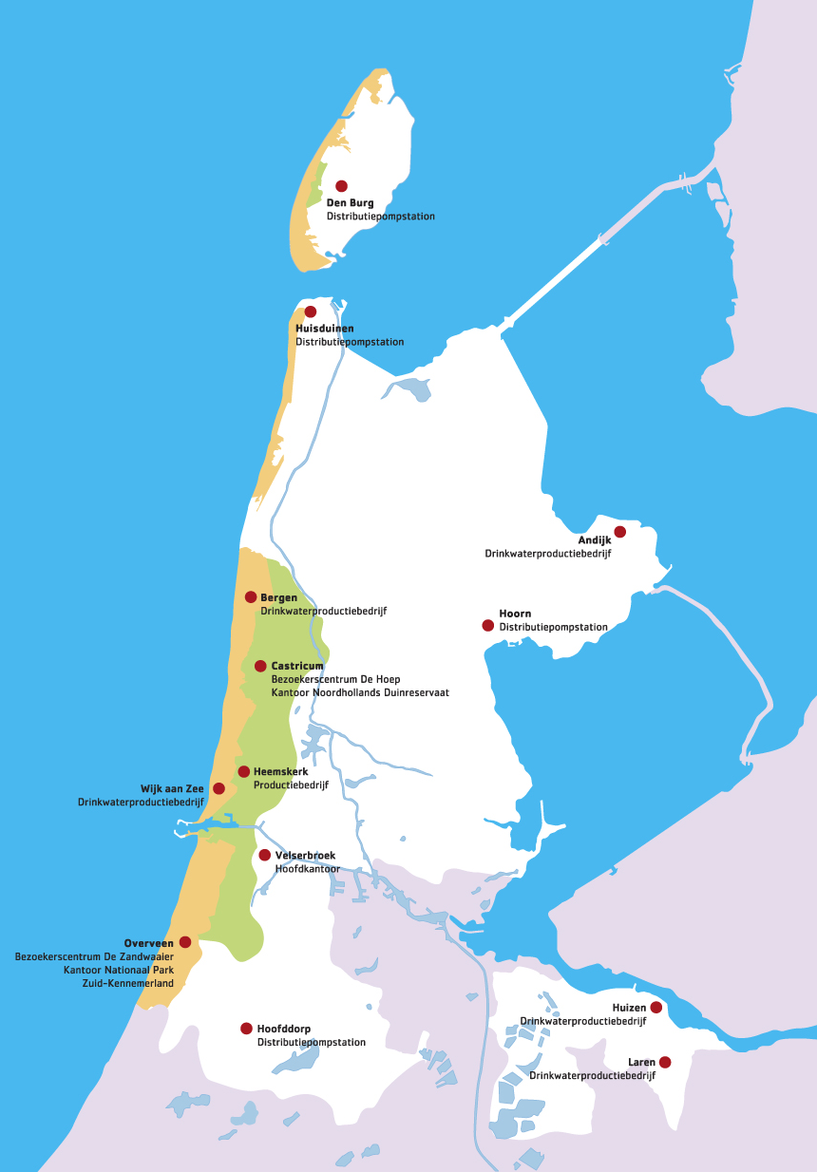
History PWN: link between water and nature
In North Holland, natural freshwater supplies are only found in the sand dunes and Gooi area.
Initially, dune water was the only source for drinking water.

Slide 12
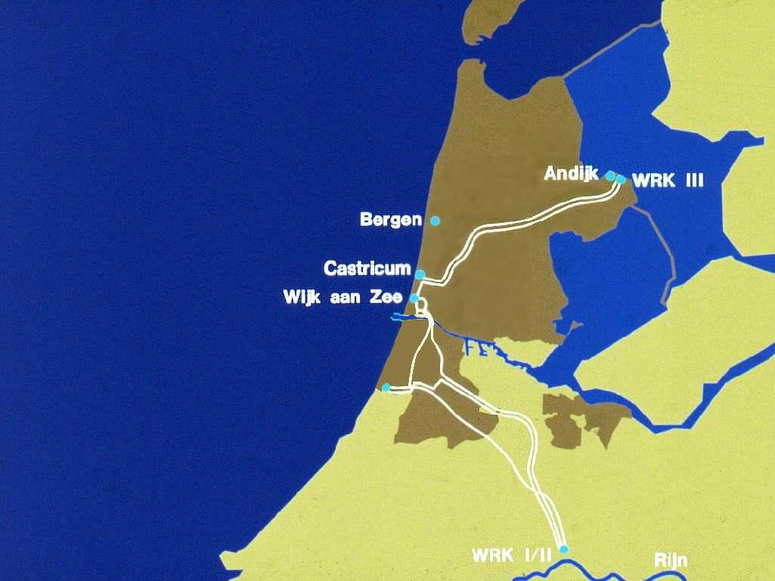
History PWN: link between water and nature
In North Holland, natural freshwater supplies are only found in the sand dunes and Gooi area.
Initially, dune water was the only source for drinking water.
From 1956 on, replenished by surface water (Lake IJssel, rivers Lek and Rhine).
The dunes are still an important strategic reservoir for drinking water in North Holland.
Without dunes no reliability of supply.

Slide 13
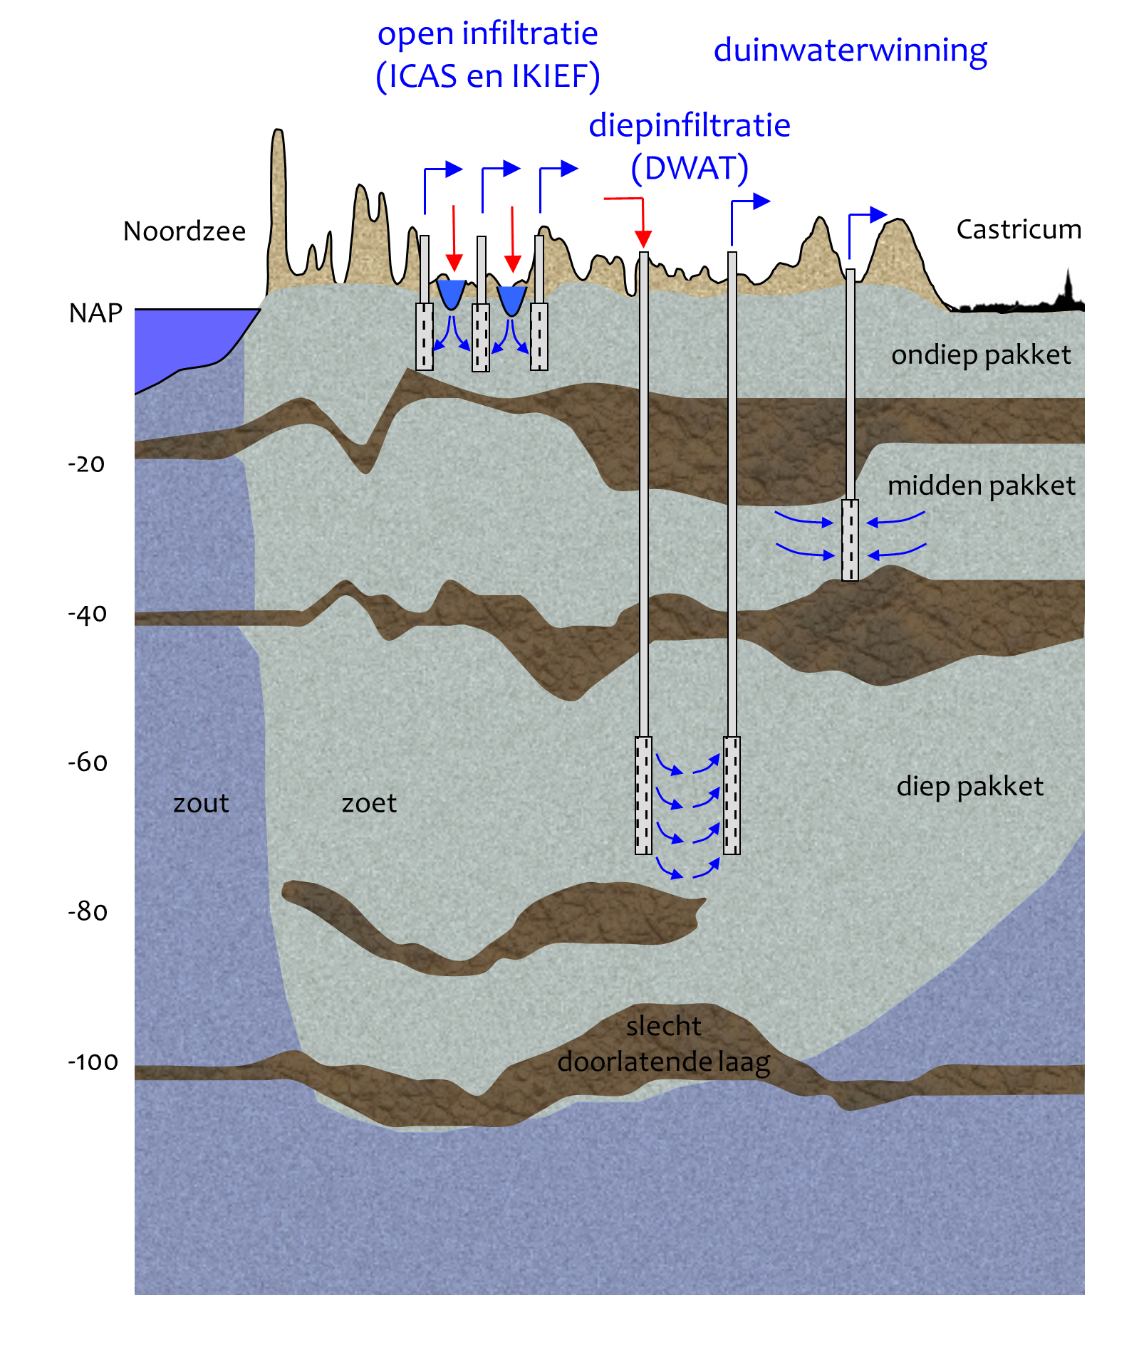
Infiltration systems

Slide 14
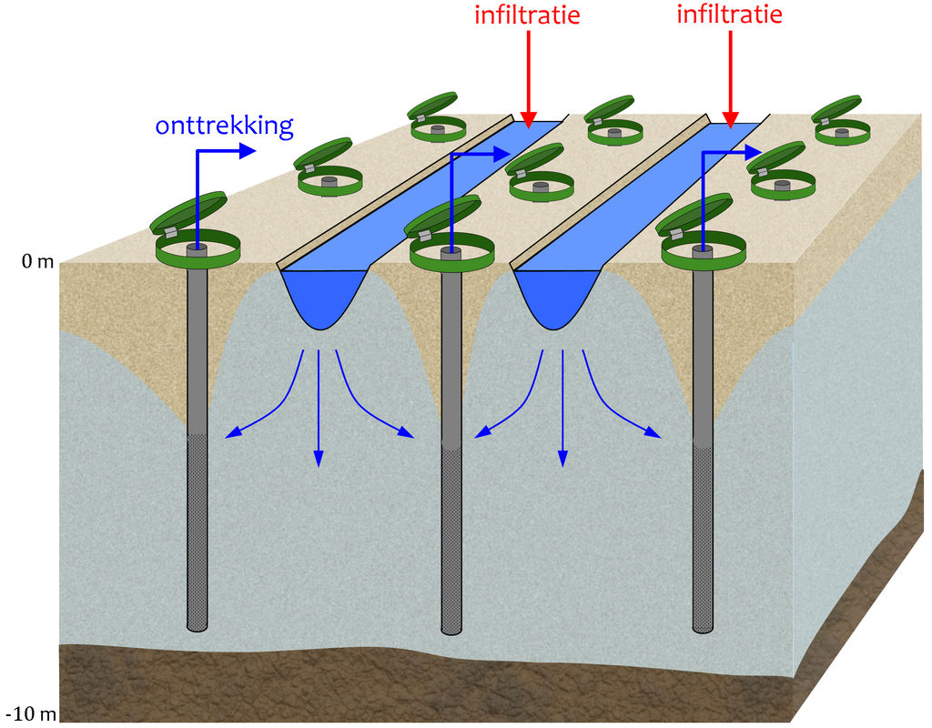
Open infiltration

Slide 15
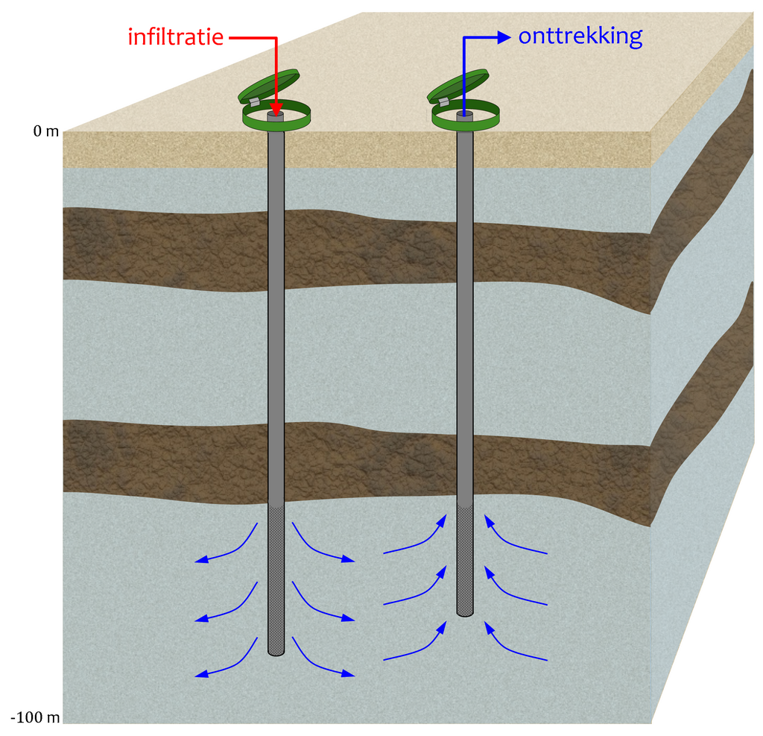
Deep well infiltration

Slide 16
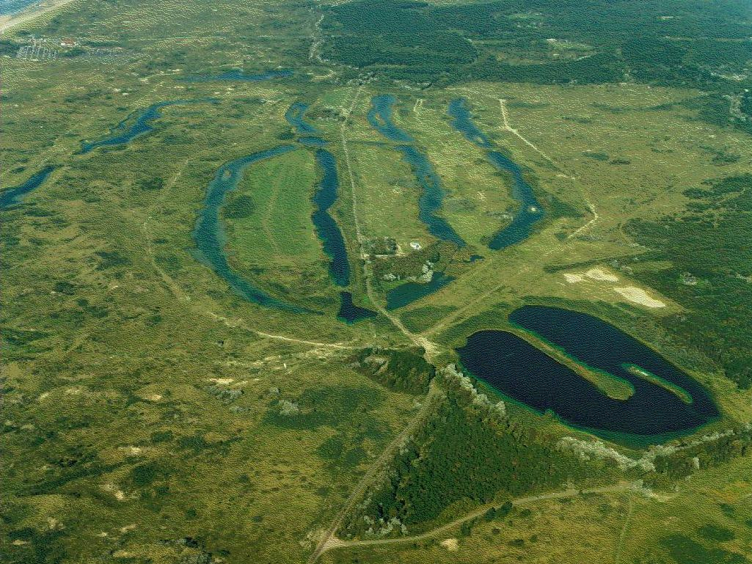
Infiltration area ICAS (1956)

Slide 17
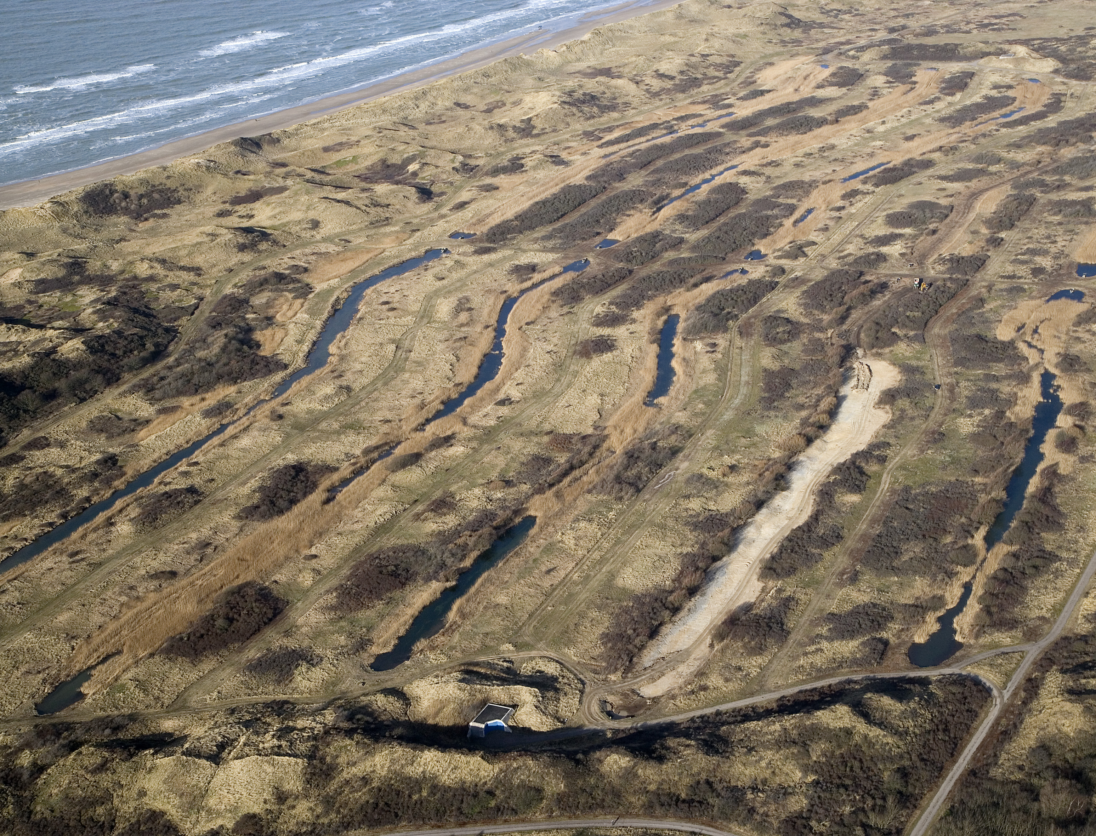
Infiltration area IKIEF (1976)

Slide 18
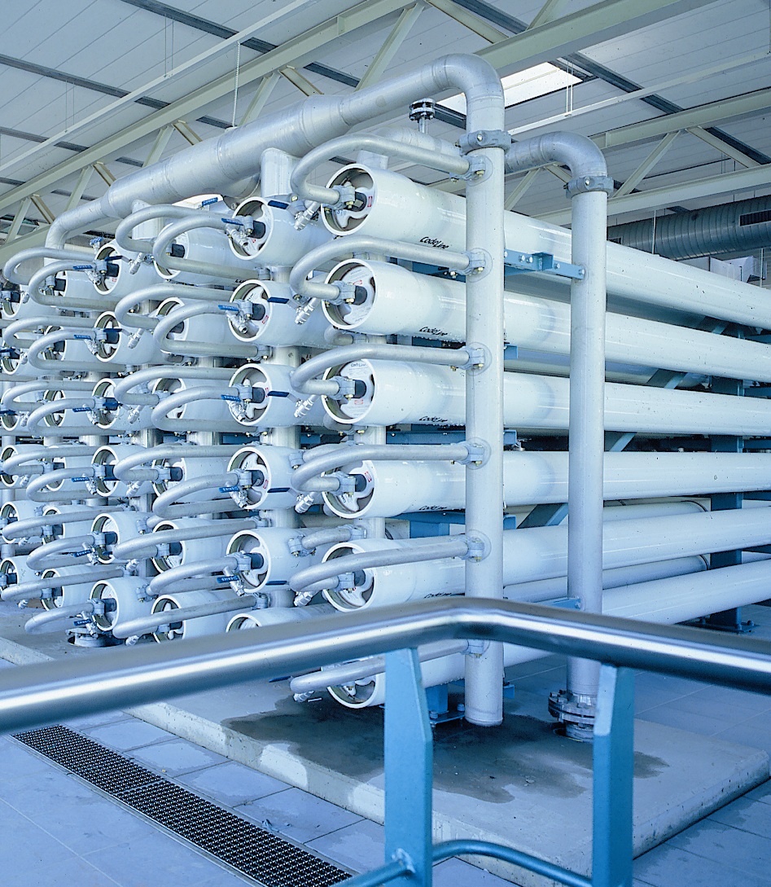
Innovation
Innovation-focused culture of PWN
results in worldwide leadership in
drinking water technology
1989 Deep-well infiltration
1999 Membrane filtration
2004 UV/H2O2
2004 Perfector-E
2008 Heemskerk 2
2008 Relining
2010 SIX technology

Slide 19
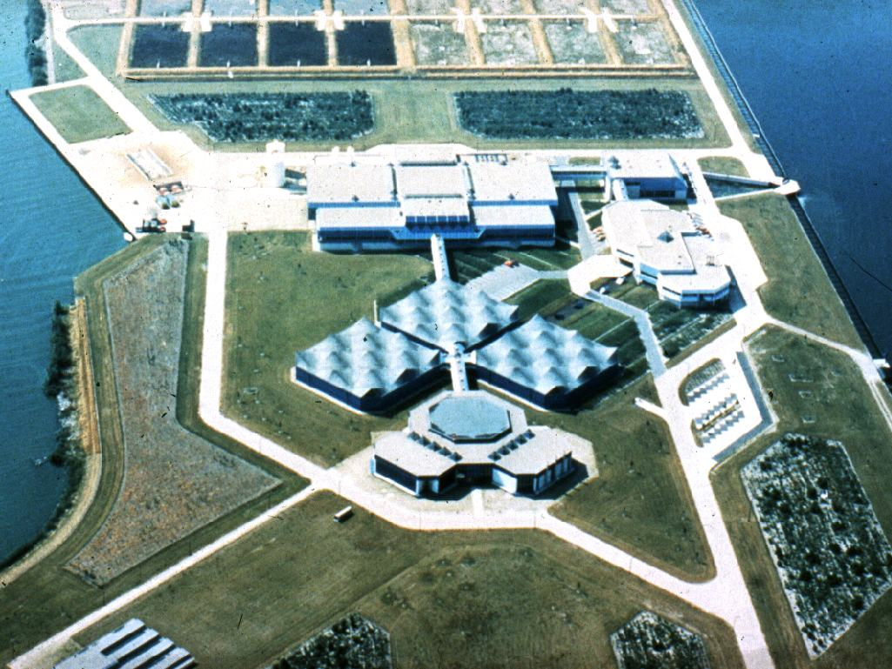
Pre-purification Andijk

Slide 20
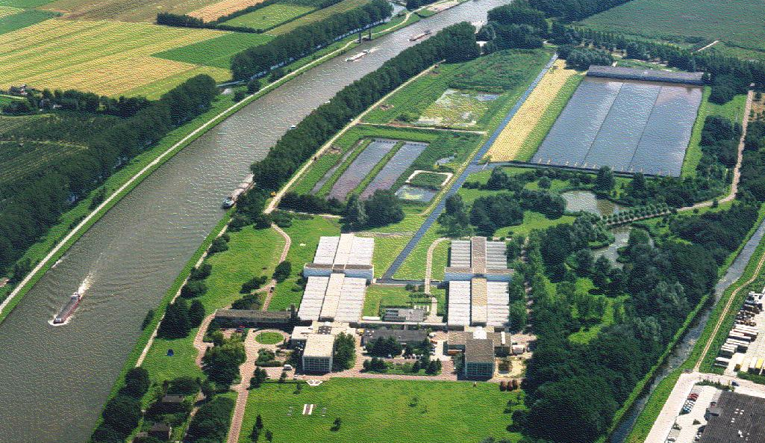
Pre-purification Nieuwegein

Slide 21
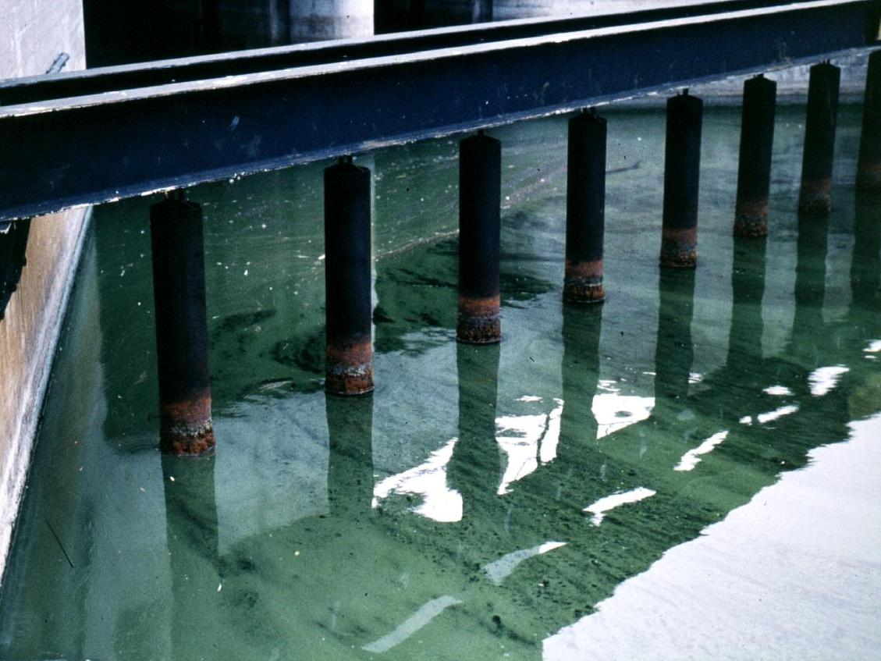
Raw water intake at Andijk
TCA
diuron
atrazine
bromacil
bentazone
2,4-D

Slide 22
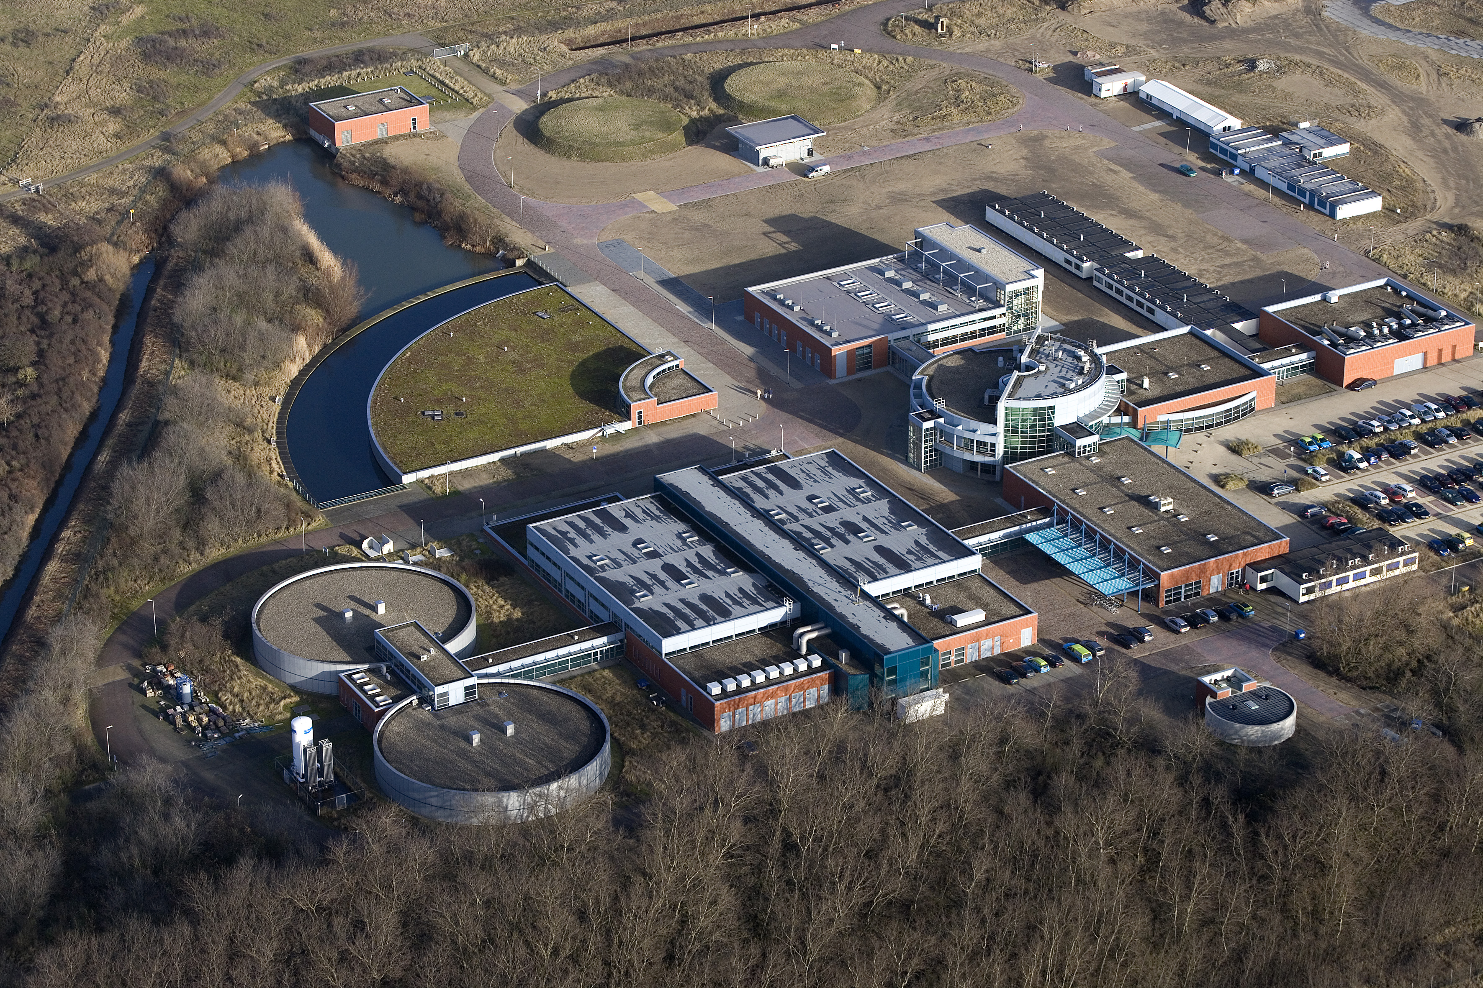
Advanced requirements
Improved drinking water quality requires:
disinfection, preferably without chlorine application
barrier for organic micro pollutants (pesticides, industrial contaminants, medicine & hormone residuals)
softening
desalination (for control of Na content)

Slide 23
Heemskerk 1
Membrane technology
Ultra Filtration + Reverse Osmosis
Characteristics
disinfection: dual barrier! --> no chlorine
softening: cost savings, consumer comfort, network protection
barrier to organic micro pollutants (pesticides, hormone & medicine residuals)
concentrate waste (brine) --> sea outfall

Slide 24
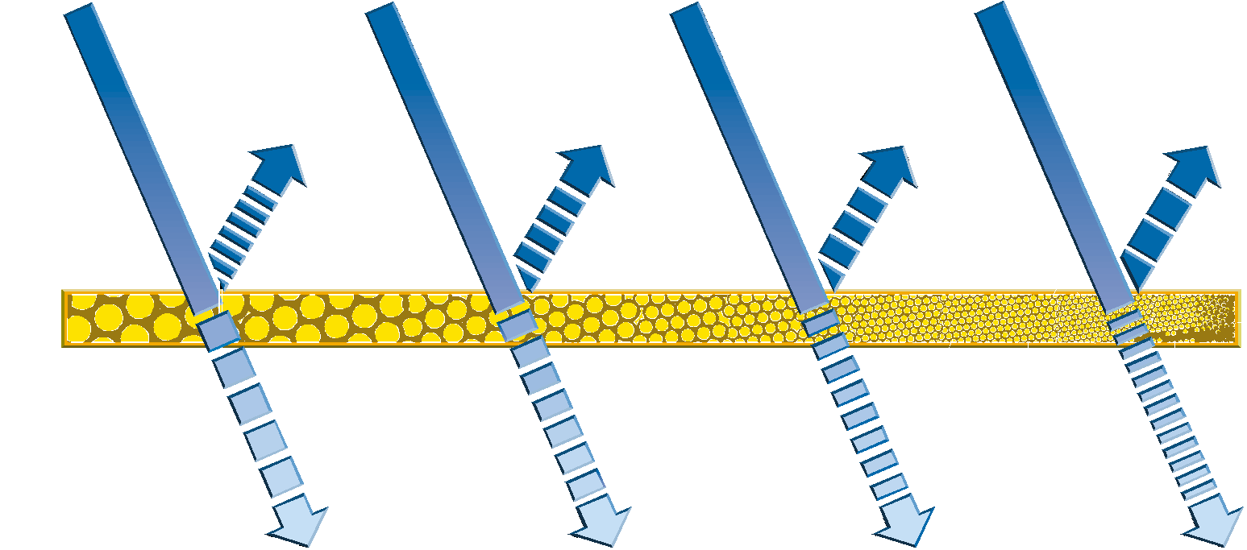
Micro
Filtration
Ultra
Filtration
Nano
Filtration
Reverse
Osmosis
giarda
crypto
bacteria
colour
hardness
pesticides
colloids
viruses
salts
colloids viruses
colour
hardness pesticides salts
water
colour
hardness
pesticides
salts
water
salts
water
water
100-1000 nm 10-100 nm 1-10 nm < 1 nm

Slide 25
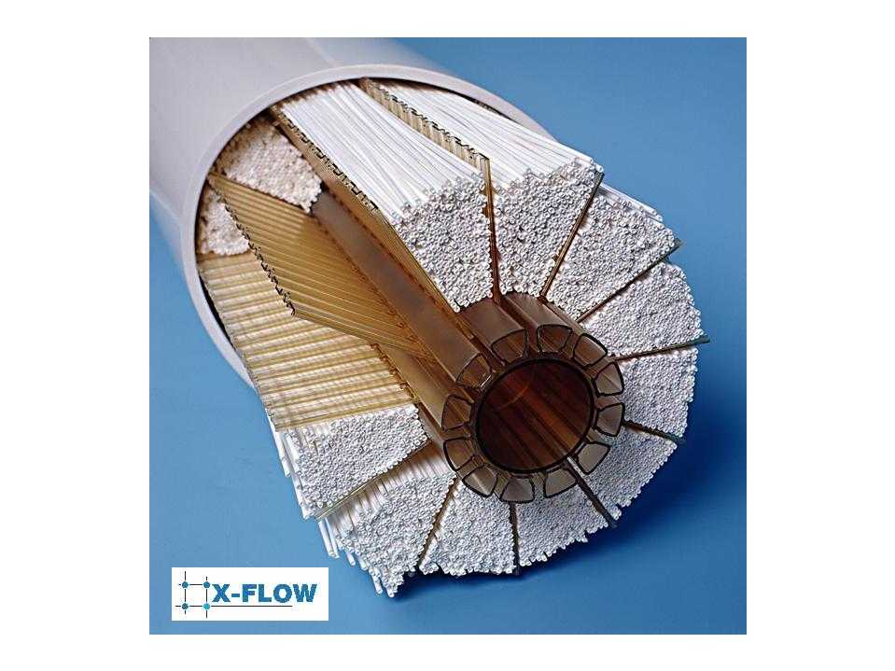
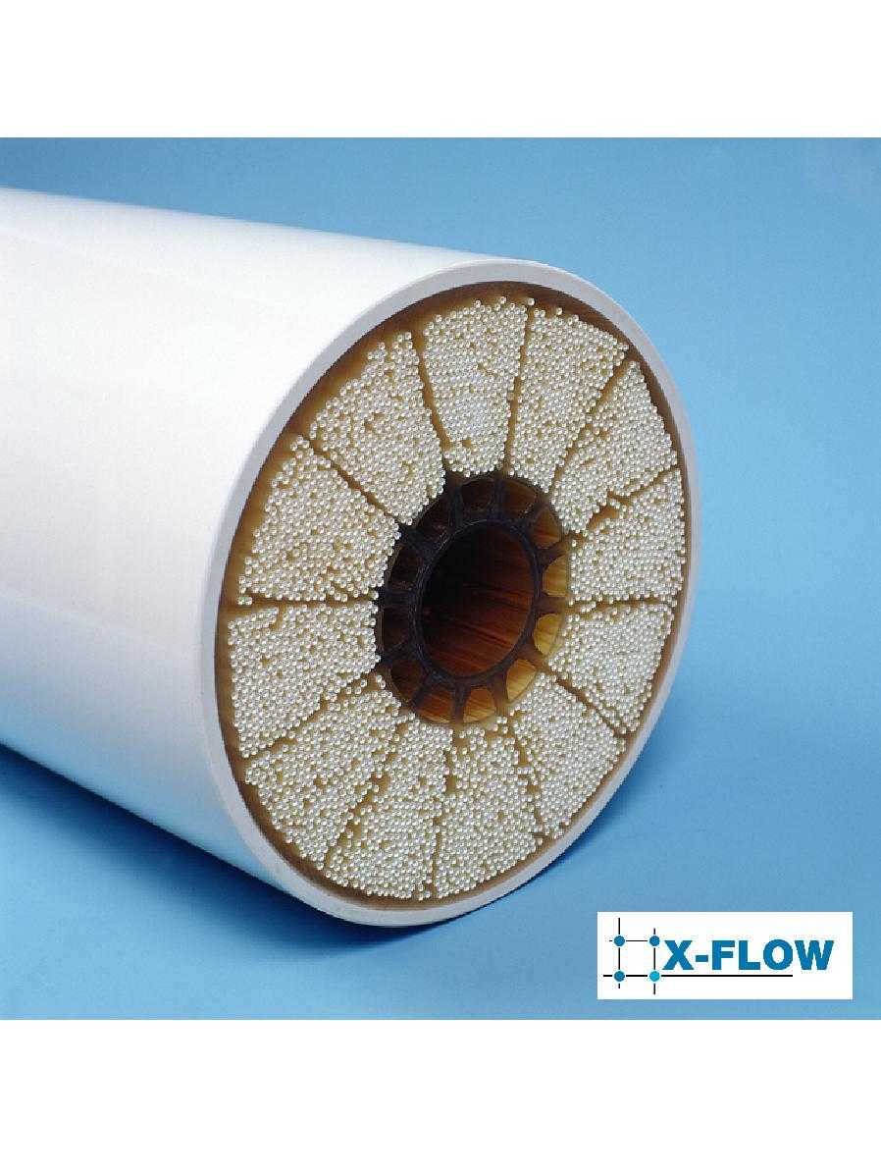
Hollow fibre UF dead end-filtration

Slide 26
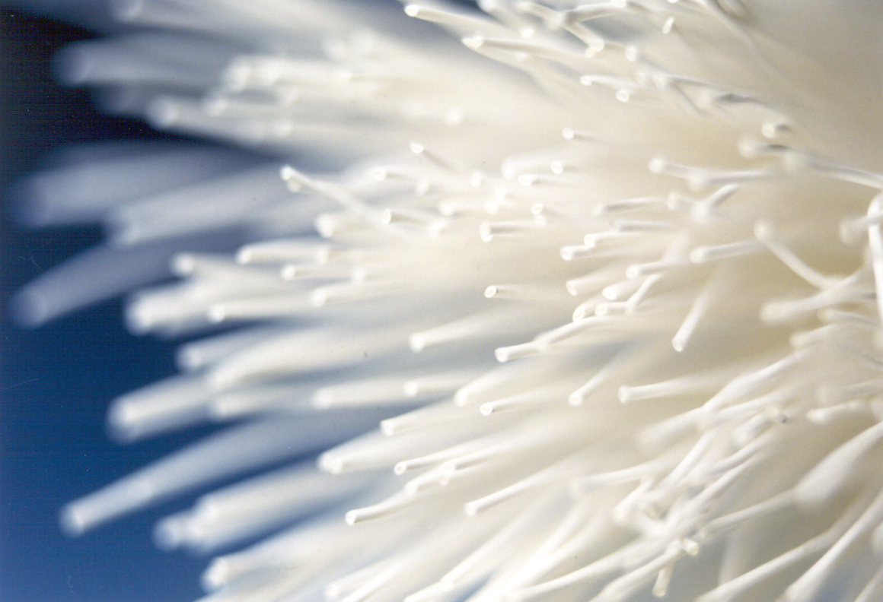
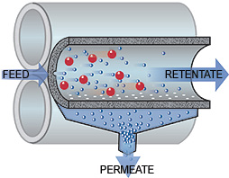
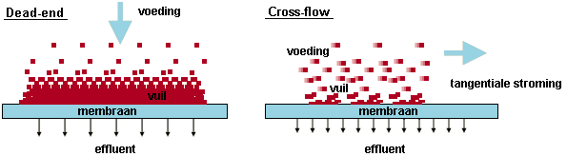

Slide 27
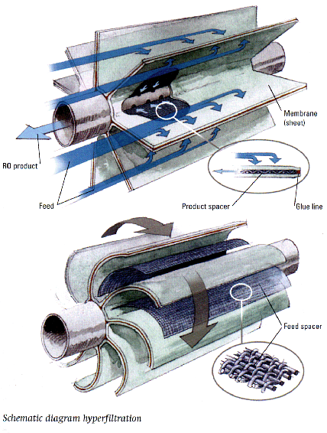
Spiral wound RO cross flow filtration

Slide 28
PFD Heemskerk 1

Slide 29
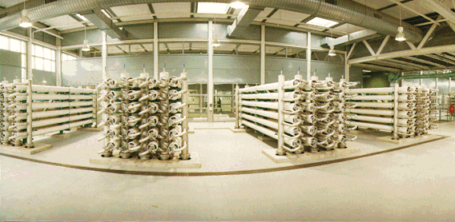
Large scale UF

Slide 30
Heemskerk 2
Technological concept:
existing pretreatment (Lake IJssel and Rijn-lek canal)
UV/H2O2 treatment
GAC reactor
dune infiltration
Characteristics
disinfection (optional)
barrier for organic micro pollutants

Slide 31
UV/H₂O₂
Principles:
UV irradiation affects DNA
UV irradiation affects organic compounds
UV + H2O2 --> OH*-radicals
OH*-radicals affect organic compounds

Slide 32
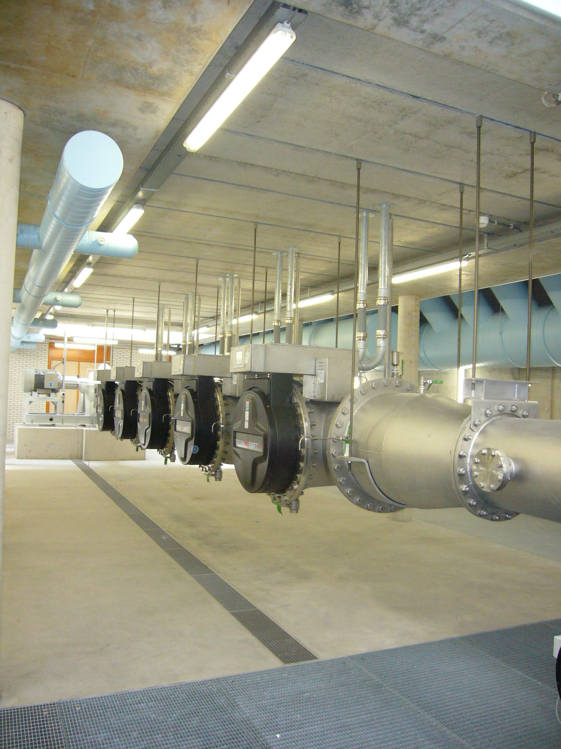
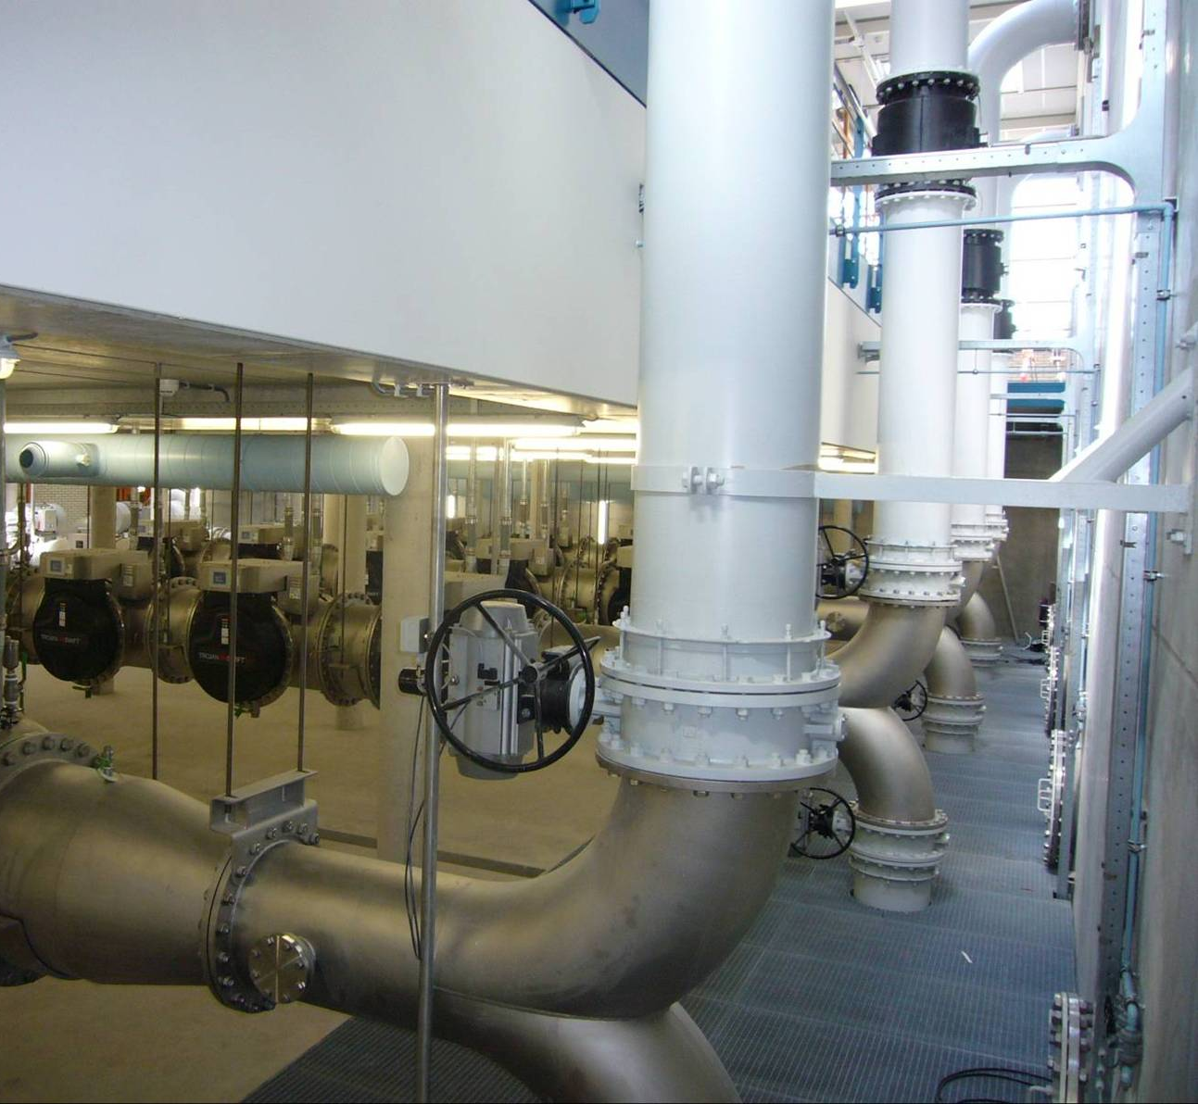
Heemskerk AOP (PSHV)

Slide 33


